Slide 1

Categories and Sample Projects
Resources provided by the West Baton Rouge Museum

Slide 2





Types of Projects
Each category is unique and requires different presentation skills
Notes:
Presentation, Documentary, Paper, Performance, Website based on student’s interests. Perhaps students who love theater what to pursue a performance while students more interested in the technological aspect will pursue a website or documentary. The teacher can also set guidelines and criteria for students. Teachers may just want to limit projects to papers or exhibitions.

Slide 3
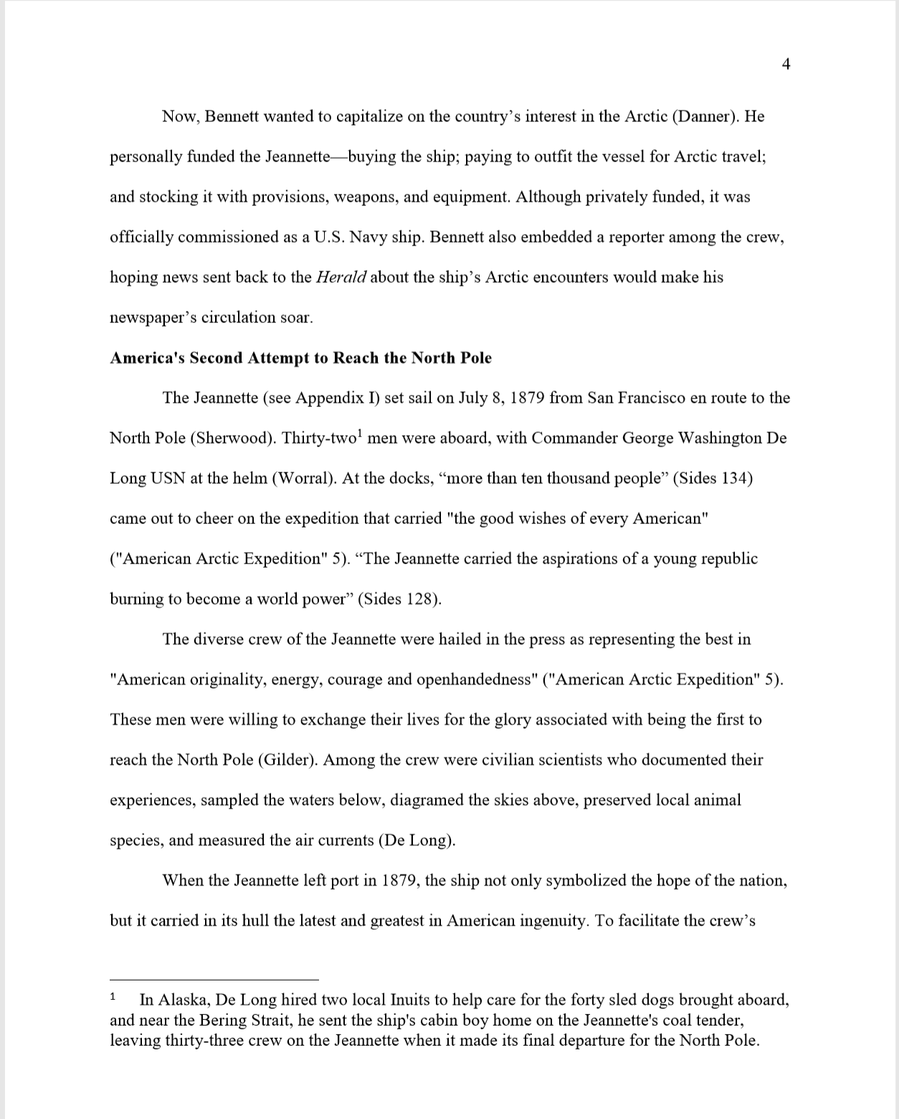
Paper
Traditional form of historical research
Must be individual
No process paper
1,500-2,500 word limit
Citations required
Double-spaced, 12-point font, 1-inch margins
Notes:
Paper from: https://www.nhd.org/sites/default/files/Ranis_Paper.pdf

Slide 4
Writing a Paper
Outline Paper
Write
Edit
Intro
Body
Conclusion
Notes:
This is an important process for all students-as all students have to do a process paper-but critical for students of the paper category b/c theirs will require extra editing and work

Slide 5
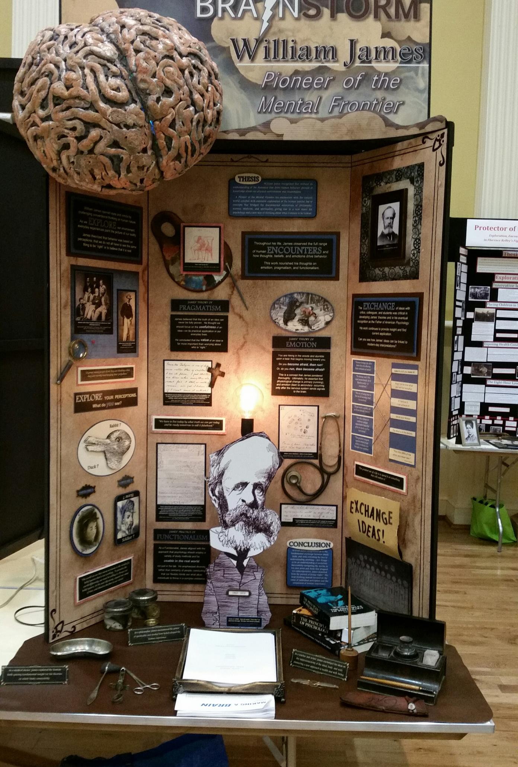
Exhibit
Three dimensional visual presentation
40’’ wide by 30’’ deep by 6’ high
500 word limit
3-minute limit on media devices
Process paper and bibliography required
Notes:
Photo from: https://www.nhd.org/sites/default/files/Nickeles%20Exhibit%201.jpg

Slide 6
What best conveys your story?
Images?
Original Text?
Quotes?
Copies of Artifacts?
Video?
Audio materials?

Slide 7
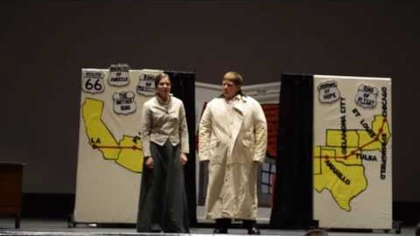
Performance
Theatrical performance
Cannot exceed 10 minutes
5 minutes to set up and take down
Can use media devices and costumes
Process paper and bibliography required
Notes:
https://www.youtube.com/watch?v=iyYz6toLXmU&feature=youtu.be
Junior Group Performance
MORE EXAMPLES:
https://www.youtube.com/watch?v=bqFJfMiadss&feature=youtu.be Senior Individual
https://www.youtube.com/watch?v=yj_xh3ywQYI&feature=youtu.be Senior Group
https://www.youtube.com/watch?v=NhiHgBZaOMk Junior Individual

Slide 8
Preparing a Performance
Write Script
Construct Set
“Block” Movements
Create Costumes
Practice

Slide 9
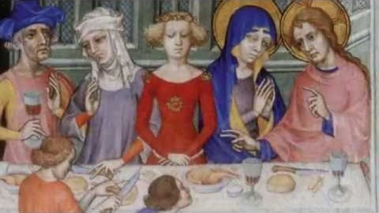
Documentary
Using audiovisual equipment to create presentation
Cannot exceed 10 minutes
Give credit to professional audiovisual material
Process paper and bibliography required
Notes:
https://www.youtube.com/watch?v=Sv_bhnojoRQ&feature=youtu.be Senior Individual
Another example:
Junior Group: https://www.youtube.com/watch?v=SnLL8b11hxk

Slide 10
Producing a Documentary
Access a video camera, computer, and editing software
1
Keep a database
2
Create a timeline
3
Allow time for editing
4

Slide 11
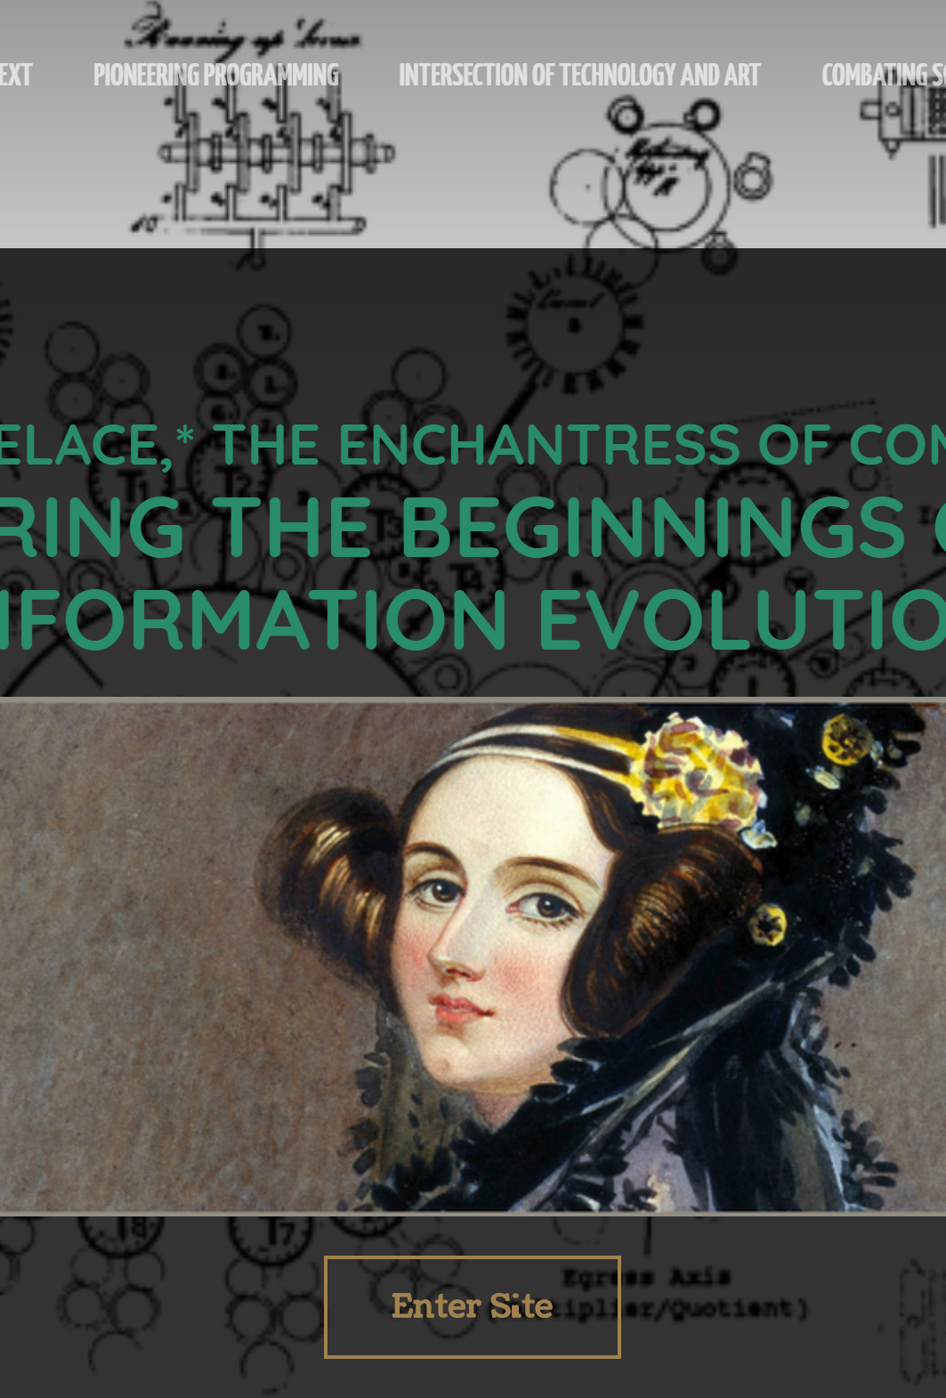
Website
Interactive collection of webpages
Must use NHD Site Editor
1,200 word limit
No more than 100MB of file space
No more than 4 minutes of multimedia clips
See example: Ada Lovelace http://51750416.weebly.com/
Notes:
Other examples: https://95698391.weebly.com/ China’s Surge into Silk: The Exploration, Encounter, and Exchange of the Silk Road
http://36229834.weebly.com/ Feminists in Flight: Exploring Gender Equality at 32,000 Feet

Slide 12
Website Tips
Keep it simple
Get inspiration from other websites
Be consistent with font and design
Follow all the rules

Slide 13

See Contest Rule Book and NHD Website for details about category projects!
https://www.nhd.org/categories
Notes:
This Photo by Unknown Author is licensed under CC BY-NC-ND

Slide 14
Making the Decision
No category is “easier” or “harder” than the others!
Pick the one that effectively conveys your topic and that you feel confident pursuing.
All categories have important rules and details-read up on your choice!
Notes:
ADD HISTORY DAY PICTURES?

Slide 15

Contact us with questions! Happy to help!

