Slide 1

Annotated Bibliography and Process Paper
Resources provided by the West Baton Rouge Museum

Slide 2

What is required?
Title Page
Process Paper
  For all categories except the paper
Annotated Bibliography

Slide 3

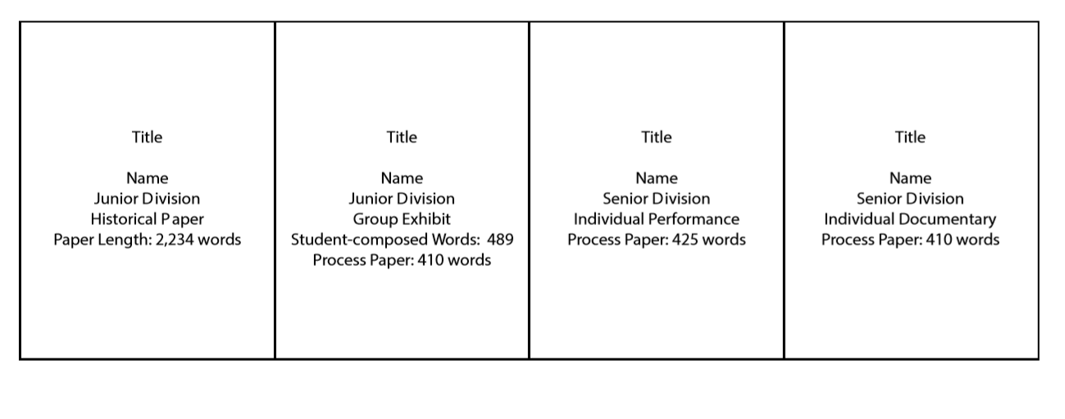
Title Page
Must only have:
  Title
  Name(s)
  Contest division
  Contest category
  Word count
Notes:
From contest rules

Slide 4
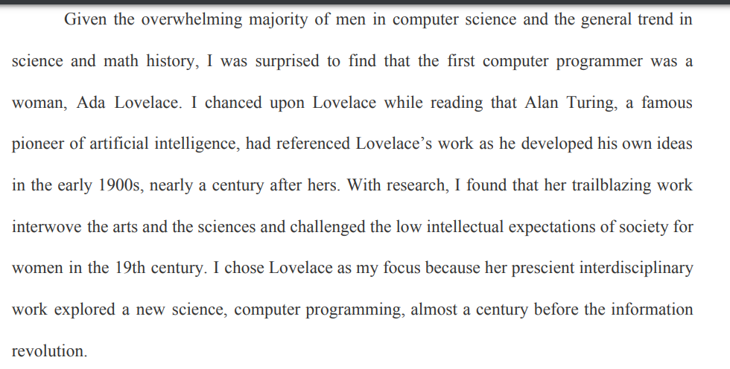
Process Paper
500 words or less
4 sections:
  How you chose topic
  How you conducted research
  How you selected category and created project
  How your project relates to NHD theme
Notes:
See examples provided in teacher’s resources for the whole paper
https://www.nhd.org/sites/default/files/processpaperstate2016.pdf

Slide 5

What is an Annotated Bibliography?
Informs the judges and readers about what information you discovered from your sources
Separates primary and secondary sources
Shows your research and time commitment to the project
Notes:
I

Slide 6
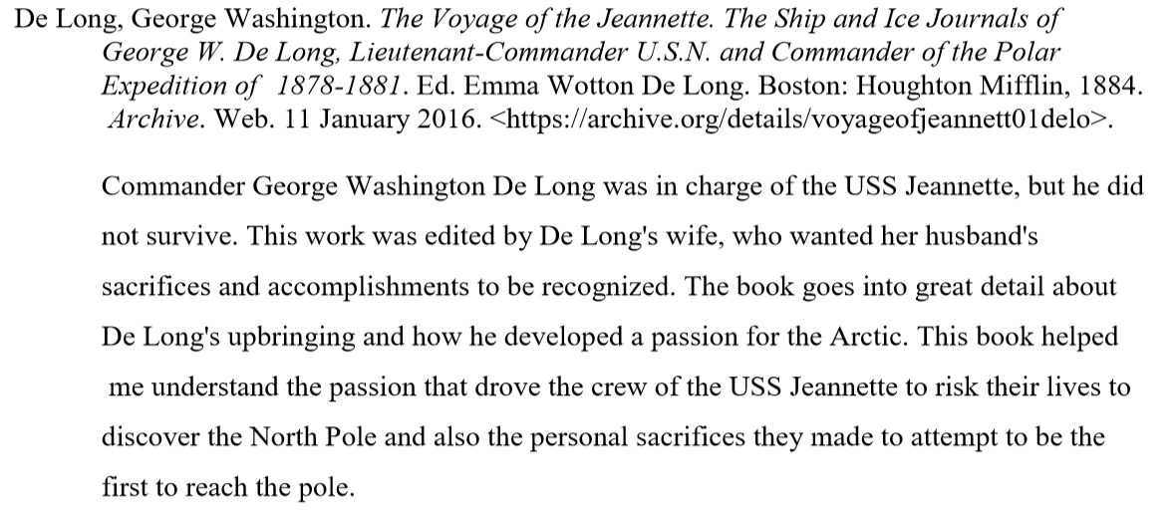
How is it different?
Annotated bibliographies have commentaries below their citations to provide readers with information about the source and its importance in your research
Use MLA OR CHICAGO STYLE
Notes:
Example from https://www.nhd.org/sites/default/files/Ranis_Bibliography.pdf

Slide 7
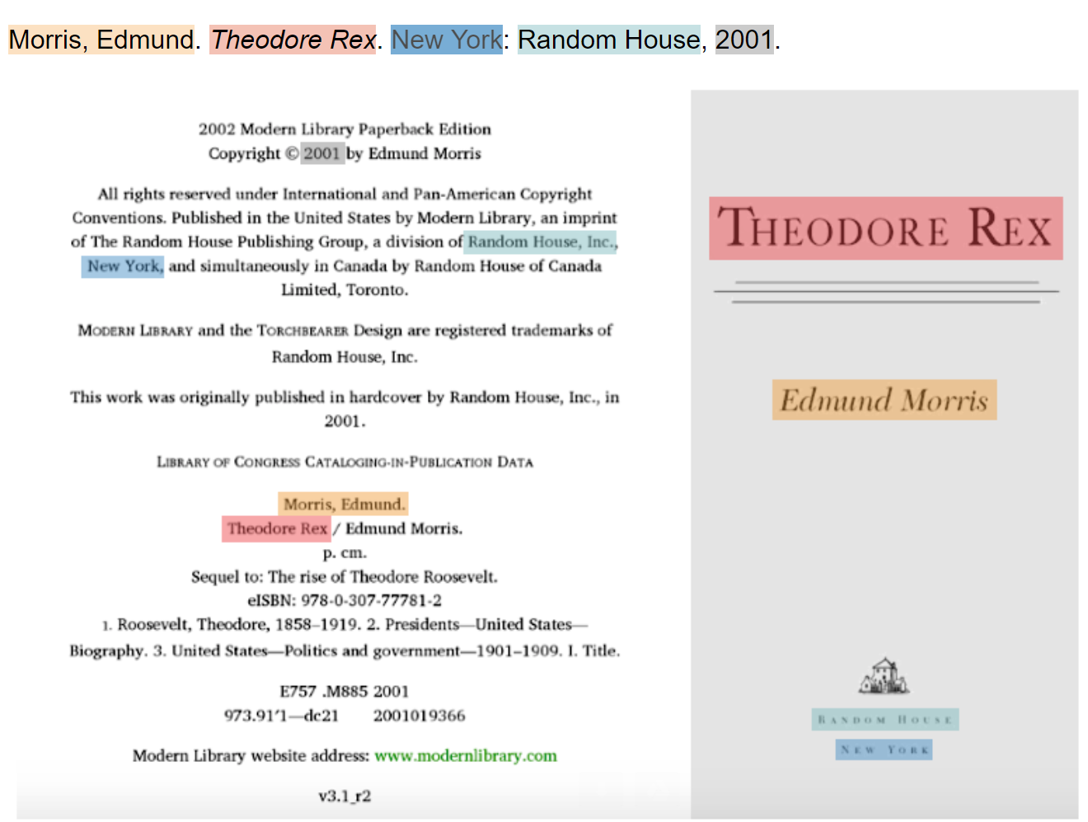
Finding Source Information
Author Name(s)
Title
Publisher and City
Date
Notes:
From: https://www.nhd.org/annotated-bibliography
Each source has different criteria for what to cite. Follow style guides that explain how to cite exactly.
All sources must be cited in the Annotated Bibliography and in the project as they are used.

Slide 8
Use Style Guides for Information
MLA
CHICAGO
https://owl.purdue.edu/owl/research_and_citation/mla_style/mla_formatting_and_style_guide/mla_formatting_and_style_guide.html
https://owl.purdue.edu/owl/research_and_citation/chicago_manual_17th_edition/cmos_formatting_and_style_guide/general_format.html
Notes:
Teachers may want to introduce certain programs that help with bibliography skills or provide a packet that teaches how to cite everything. NoodleTools offers complementary access for one NHD project season to teachers; it is a research tool and bibliography service!

Slide 9
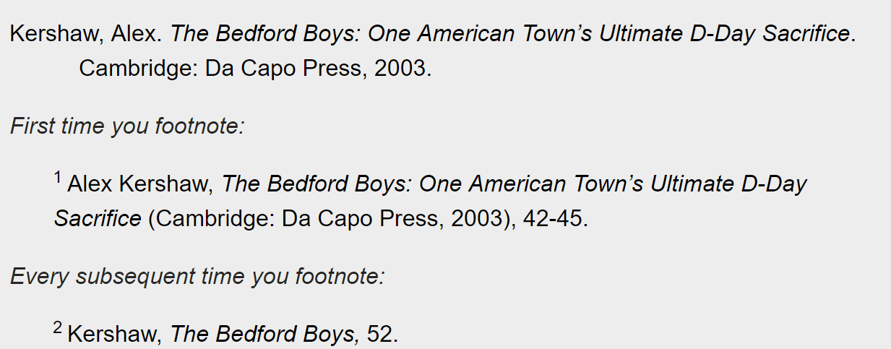
Citing Sources: Paper
Footnotes
  Used in paper when paraphrasing or quoting
  Does not interrupt the flow of your paper
  Word or other applications automatically inserts them
Notes:
Students have choice of footnotes or in-text citations for citing in the paper.

Slide 10
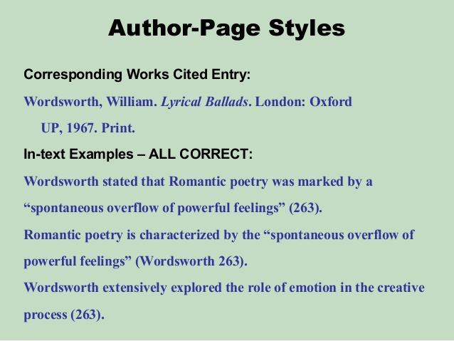
Citing Sources: Paper
Parenthetical or “In Text” References
  Leads readers to source
Be consistent: choose footnotes or parenthetical
Notes:
Example from: https://www.slideshare.net/asmithfield/parentheticalcitations
Teachers should explain how in-text citations work and use the example in the green text.

Slide 11
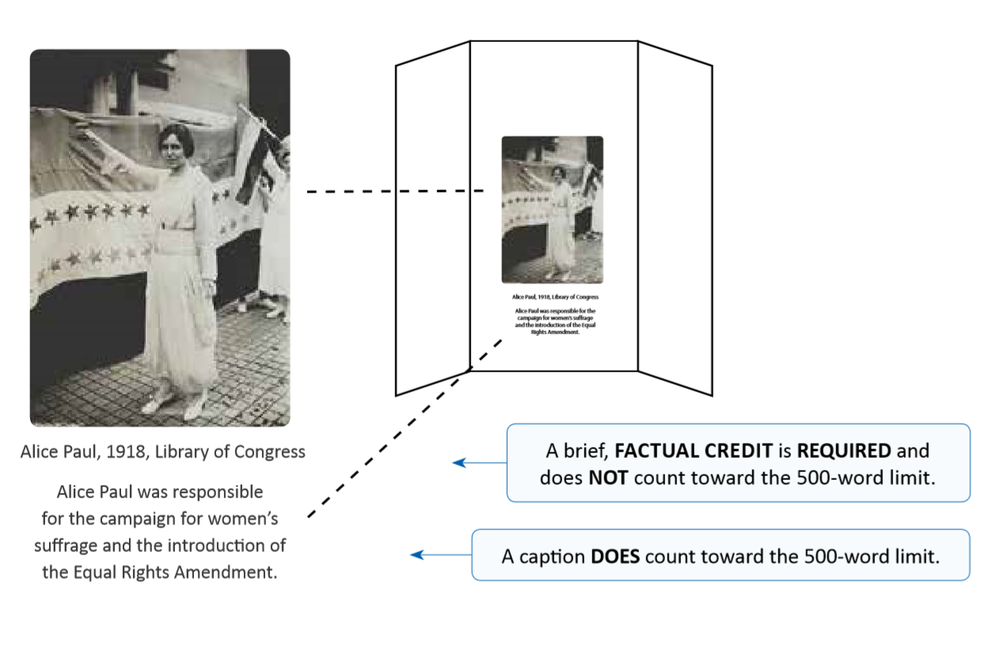
Citing Sources: Exhibits and Websites
Citations do not count towards word limit
Print Sources:
  Author
  Title
  Date
Visual Sources
  Author
  Title
  Date
  Content (who/what)
  Where Image Found (NOT JUST GOOGLE)
Notes:
Descriptions of pictures do count toward word limit.

Slide 12
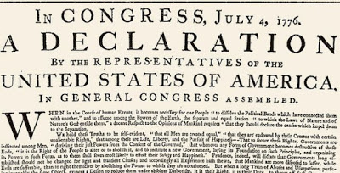
Citing Sources: Performances
Do not cite as you perform
If you want to reference primary sources say something like…
The Q&A session at the end allows judges to clarify
“I wrote a letter to King George demanding that my grievances be addressed…”
Notes:
This Photo by Unknown Author is licensed under CC BY
Example from NHD Website.
All sources will be cited in the Annotated Bibliography as well!

Slide 13
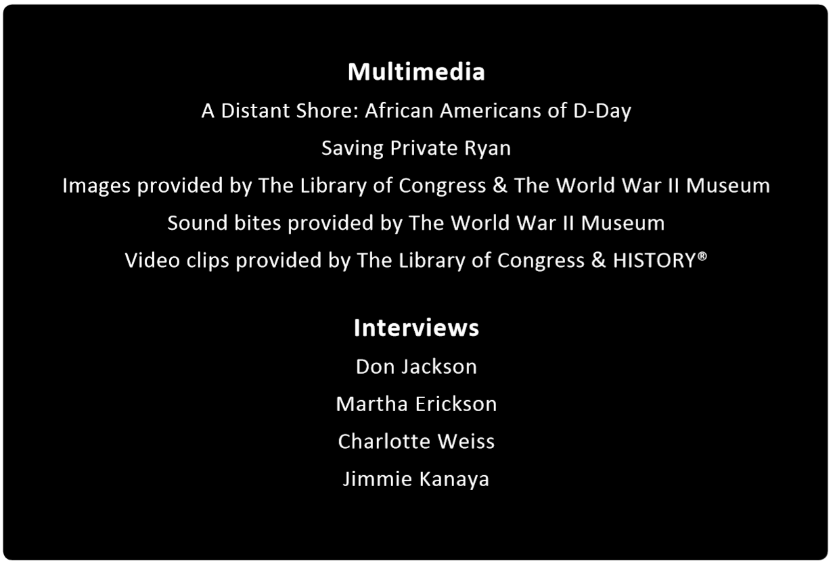
Citing Sources: Documentaries
Not required to cite images as they appear on screen
List brief page of sources at end
The Q&A session at the end allows judges to clarify
Notes:
Picture from: Contest Rule Book https://www.nhd.org/sites/default/files/Contest-Rule-Book_2.pdf
All sources are cited as well in the Annotated Bibliography

Slide 14
Constructing the Bibliography
Title the page “Annotated Bibliography”
01
Divide paper into “Primary Sources” and “Secondary Sources”
02
Alphabetize the sources in their sections
03
Single-space entries and skip one line between
04
Do not hyperlink URLs
05

Slide 15
Writing an Annotation
The type of source
How the source was used
How the source helped you understand your project
Notes:
Three essential parts to writing an annotation! Address them all every time!

Slide 16
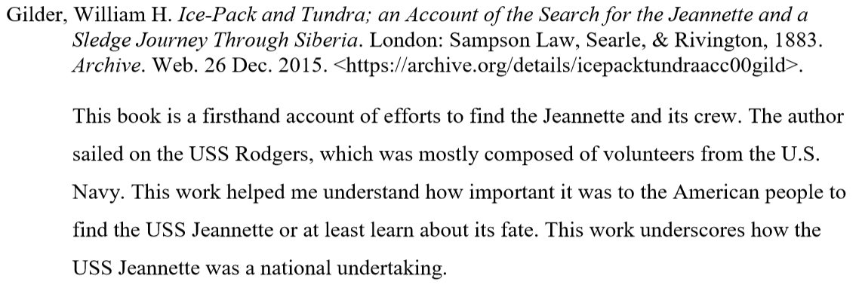
Dissecting an Annotation
Type of Source
Source Usage
Understanding Source
Notes:
Example from: https://www.nhd.org/sites/default/files/Ranis_Bibliography.pdf

Slide 17
Annotating
Normally, keep it concise: 2-5 sentences!
If it is unclear if the source is primary or secondary, explain your choice
Quality sources over quantity sources!!
But cite everything you USE!

Slide 18
Tips
Stay Organized
Keep Source Sheets
Do annotations as you research
See NHD Website for Examples
Notes:
https://www.nhd.org/annotated-bibliography
More information about Annotated Bibliographies above

Slide 19

Contact us with questions! Happy to help!

