Slide 1

How To Do Historical Research
Resources provided by the West Baton Rouge Museum

Slide 2
Research is a Process!
Organization
Topic Selection
Background Research
Narrow Topic
Get Info
Analysis
Develop Thesis
Conclusion
Notes:
Emphasizes that some of these steps happen at the same time and without you even thinking about them! Based on last powerpoint students might already have completed topic selection, background research and narrowed topic.

Slide 3

#1 Rule!
Stay organized!
Gather notebooks, binders, highlights, ect.
Use Source Sheets to keep track of everything!
Notes:
Teachers should provide source sheets to their students to keep track of their information! All students are responsible for creating an annotated bibliography-these can be very overwhelming unless students make it easy for themselves in the beginning!

Slide 4
Topic Selection
Follow your interests
Explore the broad background of your time period and context
Explore how your topic relates to the theme
Interest: Women’s History
Theme: Taking a Stand in History (2006)
Broad: Beauty Pageants
Narrow: Protest at the 1968 Miss America Pageant: Taking a Stand Against Media Images of Women
Notes:
Example from: A Guide to Historical Research Through the National History Day Program

Slide 5
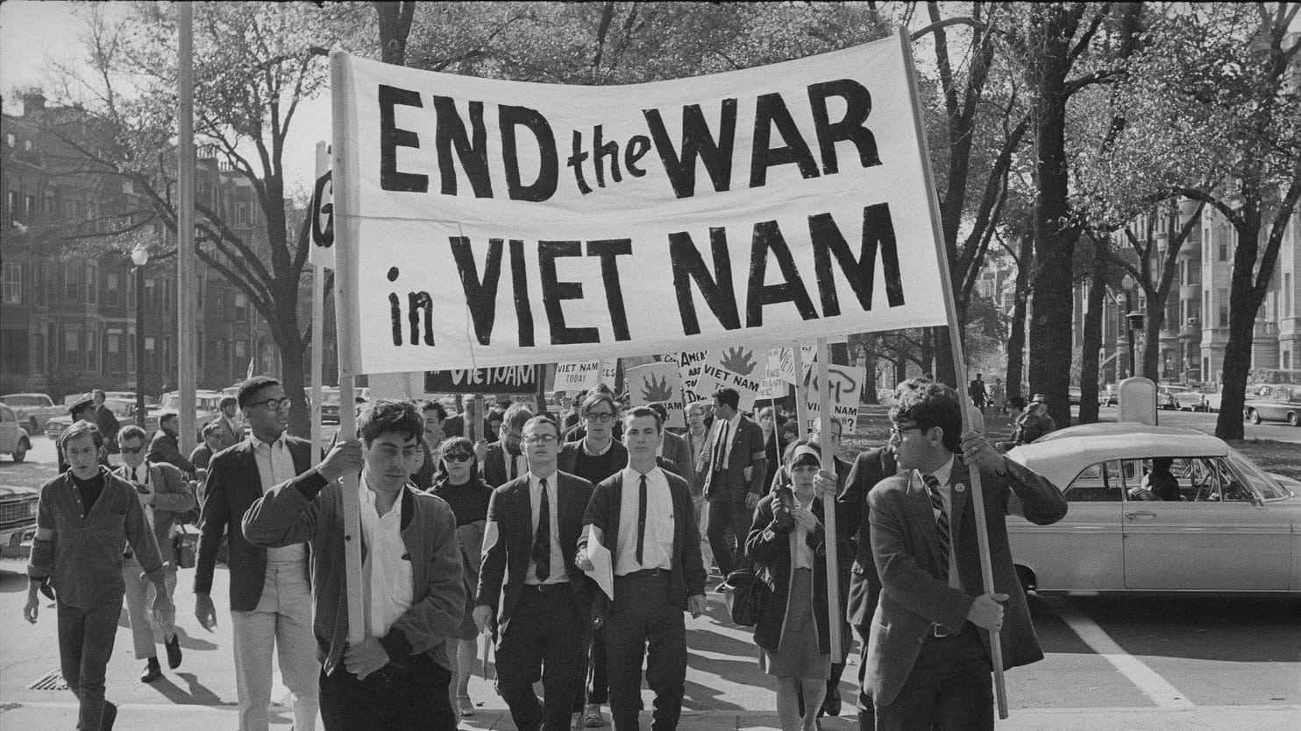
Research Question(s)
Let your research be guided by a research question
How did anti-war activism during Vietnam influence American culture?
Why is blues music important in West Baton Rouge Parish’s history?
Ask “How” and “Why” questions!
Notes:
Guiding questions lead to more research; how did this event shape history? What changed? What is significant?
Picture from: https://www.washingtonpost.com/lifestyle/style/the-civil-rights-and-vietnam-protests-changed-america-today-they-might-be-illegal/2017/09/22/ae57f778-9ed9-11e7-8ea1-ed975285475e_story.html?utm_term=.fc15c526b07e

Slide 6
Titles
After you narrow down your topic, come up with a title that connects with the theme!
Some of last year’s winning titles (Theme was Conflict and Compromise):
The Triangle Shirtwaist Factory: Fiery Conflict Sparks Compromise
A Splash in History: The Conflict and Compromise of the Indus Waters Treaty
Great Lakes Great Legacy?: The Compromise of the Great Lakes Water Quality Agreement
Notes:
Titles from 2018 Conflict and Compromise Winners

Slide 7
Sources
Primary
Secondary
“A piece of information about a historical event or period in which the creator of the source was an actual participant in or a contemporary of a historical moment.”
“A source that was not created first-hand by someone who participated in the historical era. Secondary sources are usually created by historians, but based on the historian’s reading of primary sources.”
Notes:
Definitions from: A Guide to Historical Research Through the National History Day Program

Slide 8

Primary Sources
Explore peoples’ experiences in that time period without biases of modern era
Unique perspectives
Examples:
Old letter written by family member
Speech by George Washington
WWII photograph
Notes:
Image from Powerpoint online images

Slide 9

Secondary Sources
Allow for contextualization and understanding the big picture
Clarification of facts and information
Lead you to other sources
Examples:
Biography of Eleanor Roosevelt
Article about Black Death Plaque
Interview of university professor about Native American culture
Notes:
Image from Powerpoint online images

Slide 10
Primary or Secondary?
Textbook
Autobiography by soldier
Copy of a painting with a narrative text
Manuscript Collection
Encyclopedias
Caption created by modern author for photo from the 1940s
Newspaper article written in 21st century about 1900s
Physical remains
Original Photograph during Great Depression
Oral interview from POW
Diaries
Government records
Notes:
Textbook, copy of painting, encyclopedia, caption created by modern author, newspaper article are secondary and all rest are primary
Make students explain why!

Slide 11
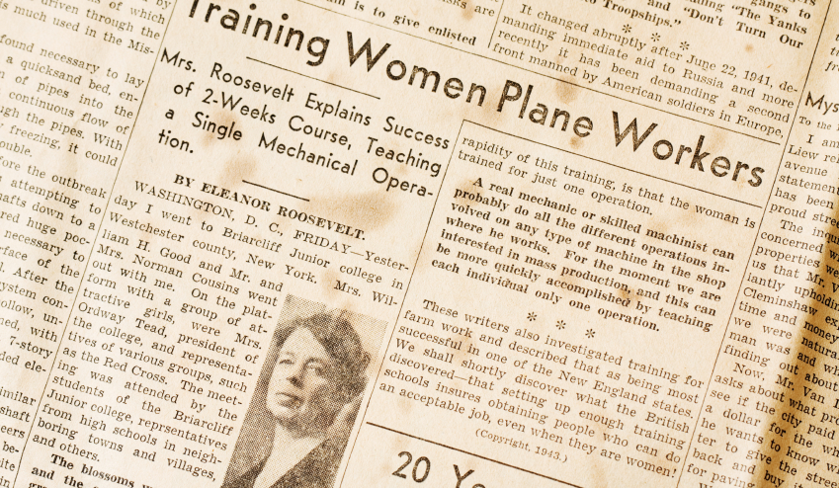
Using Sources!
NHD projects need both primary and secondary sources to be successful!
Primary is not necessarily better –Use a variety of sources
Keep track of the difference for the annotated bibliography
Notes:
https://guides.lib.unsw.adfa.edu.au/c.php?g=436295&p=2974521
Critical to have both types of sources for the annotated bibliography. Have students keep track of the types of sources as they go so it is easier when they come to the end.

Slide 12
Paraphrasing, Summarizing, and Quoting, Oh My!
Everything will need to be cited! Be smart and keep notes as you go!
Paraphrasing: Own words but around same length as original statement
Summarizing: Own words but shorter; use key points
Quoting: Keep source’s words to capture tone and authority of statement
Notes:
These are important skills to learn; teachers should clarify when students should use these techniques. Paraphrasing for personal notes, etc.

Slide 13

Advance Your Research
College Libraries
College Professors
Historical Societies
Historical Sites/Monuments
Oral Histories/Interviews
Newspapers
Artifacts
Archives
Private Collections
Family Records
Businesses/Corporations
Non-Profits/Community Centers
Notes:
This Photo by Unknown Author is licensed under CC BY-ND
This Photo by Unknown Author is licensed under CC BY-SA-NC

Slide 14
Tips
Ask Librarians for help to online resources like WorldCat
Reach out to the community
Use Online Journals
Explore article’s bibliographies and references
Use Interlibrary Loans
Conduct Interviews

Slide 15
Reaching out for Resources
You never know who can help you!
Reach out via email, phone call, or mail to:
Experts in your topic
Family members
Community members
Museum directors or librarians
Other teachers
People who experienced your topic
Notes:
Perhaps teachers can helps students come up with a list of people to reach out to along the way.

Slide 16

Interviewing-A Great Resource!
Notes:
Great minute video; 8 minutes but great watch!! Really good tips!! Could speed up video

Slide 17
Analysis and Contextualization
Once you’ve gathered substantial research, connect the dots!
Evaluate the reliability and value of your sources
What is the author trying to convey? Is their conclusion soundly backed by evidence? How does the evidence benefit your project?
Find larger patterns between your sources
Notes:
This is an important step in understanding and connecting all the research. Once you have all of the research; what is the conclusion? What is your argument?

Slide 18

SO WHAT?
Evaluate the impact of your project in its immediate historical context and determine its long-term significance!
This Photo by Unknown Author is licensed under CC BY-SA

Slide 19
Thesis Statement
Narrowed Topic
Connection to Theme
Strong Argument and Evidence
Effective Thesis Statement

Slide 20

Examples of Thesis Statements
“The advent of air conditioning spurred the migration of Northerners to the Southern states such as Florida. This shift significantly changed the economy and culture of the South.”
“Apollo 13’s encounter with disaster caused NASA to realize that stronger precautions had to be taken in space exploration.”
“The Battle of Gettysburg turned the tide of the Civil War from the South to the North, pushing back Lee’s army that would never fight again on Northern soil and bringing confidence to the Union army.”
Notes:
From Guide to Historical ResearchThis Photo by Unknown Author is licensed under CC BY-SA

Slide 21

Keep Going
Don’t Give Up!
The research project is a process and takes time, but if done well yields a successful and fun project!
Ask friends, teachers, parents, guardians, and family for motivation and guidance!
Notes:
Image from Powerpoint online images

Slide 22

Contact us with questions! Happy to help!

