Slide 1

Introduction to National History Day
Resources provided by the West Baton Rouge Museum

Slide 2
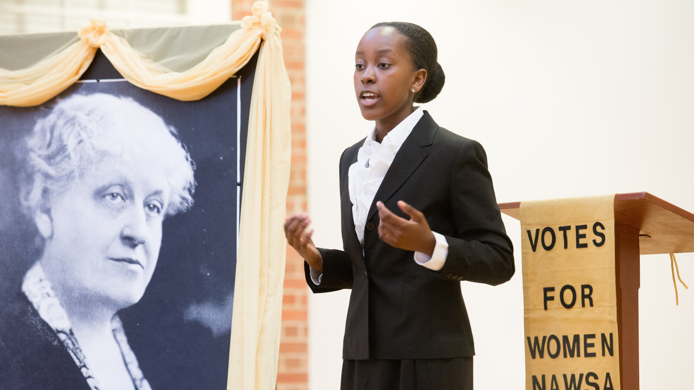
What is NHD?
A national academic history competition for students to explore their interests, master new skills and create a project!
NHD takes you in the past and beyond the classroom!
Notes:
an academic national history competition that allows students to develop papers, documentaries, exhibitions, performances, and websites for participation in local, regional, and national contests.
Picture from Media Resources National History Day
It allows you to delve into a subject of your choice, become an expert in that field, create a creative project, master new skills, and present your work at local, regional and even national competitions. This project is going to allow students to explore their passions and learn valuable skills.

Slide 3





Types of Projects
Notes:
Presentation, Documentary, Paper, Performance, Website based on student’s interests. Perhaps students who love theater what to pursue a performance while students more interested in the technological aspect will pursue a website or documentary. The teacher can also set guidelines and criteria for students. Teachers may just want to limit projects to papers or exhibitions. The choice of topic normally comes after one picks their topic

Slide 4
Details
Junior Division: 6th-8th
Senior Division: 9th-12th
Group (2-5 people) or Individual Projects
But no group papers
All projects complete a process paper!
Notes:
A process paper is up to 500 words and includes and annotated bibliography. Another powerpoint will address the details of it.

Slide 5

Delving Deeper
Competition locally, regionally, and nationally
Scholarship opportunities
Development of critical thinking, problem solving, and presentation confidence
Traveling to Washington D.C. and meeting new people
Notes:
WATCH VIDEO!

Slide 6


What are barriers? Are they all visible?
How do barriers affect social, religious, economic, cultural, and political contexts?
What is the relationship between individuals, institutions, the environment, and/or barriers?
Is breaking a barrier always positive?
Notes:
Ask these questions to your students to get them think about their topic; it is very important that topics link to the theme of NHD

Slide 7

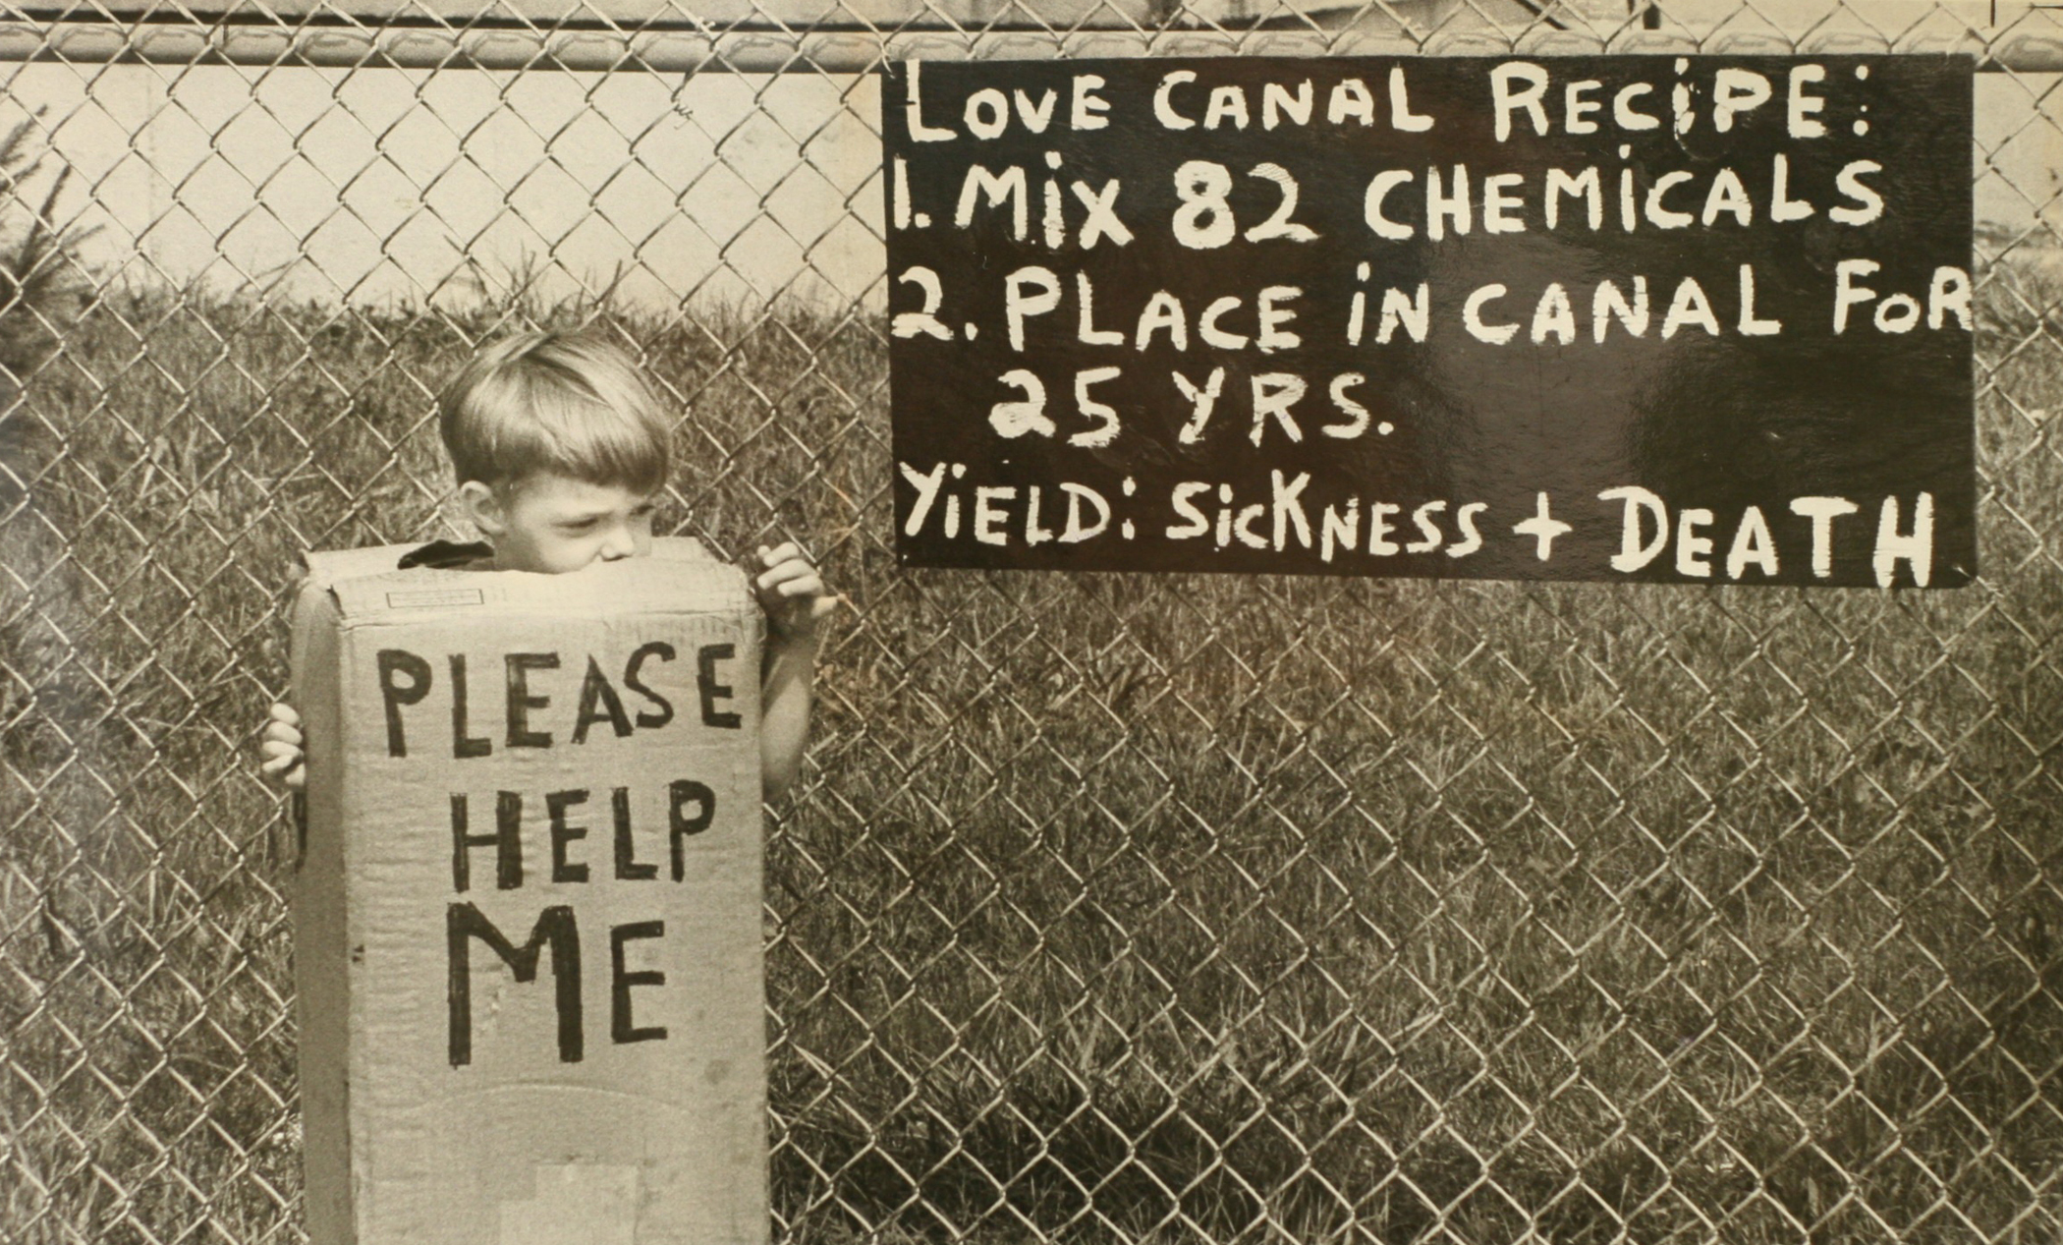

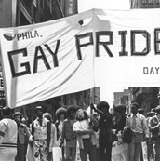

What Interests You? The possibilities are limitless!
Notes:
What kind of history interests you? Look at worksheet provided in NHD in Classroom packet. Women’s history? Military? Environmental? LQBTQ+? Political? Cultural? Art history?
Pictures from:
Rosie: https://www.washingtonpost.com/news/retropolis/wp/2018/09/03/rosie-the-riveter-isnt-who-you-think-she-is/?noredirect=on&utm_term=.29d029b93b3a
Philadelphia Gay Pride: https://www.nps.gov/subjects/urban/philly-lgbtq.htm
Love Canal:https://ejatlas.org/conflict/love-canal-niagara-falls-usa
Kennedy: https://www.nytimes.com/2016/08/29/opinion/why-did-we-stop-teaching-political-history.html

Slide 8

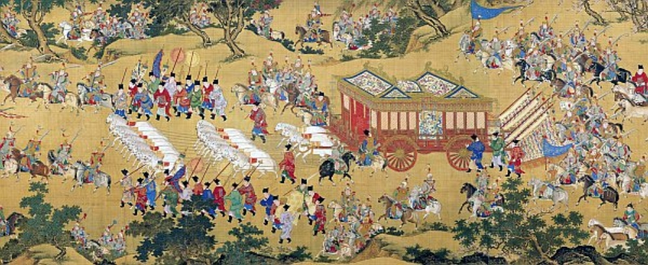
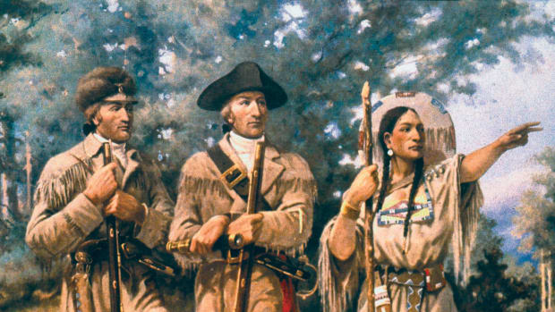
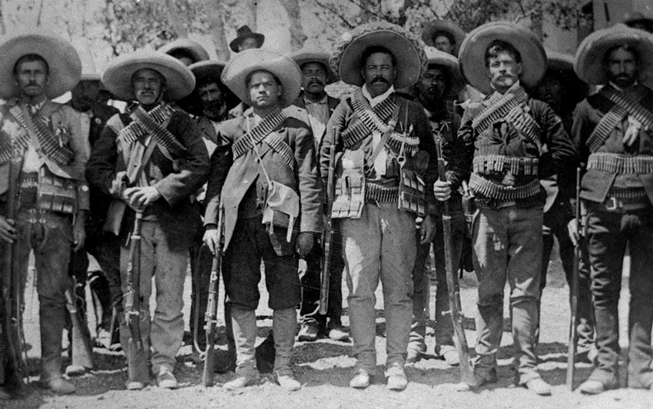
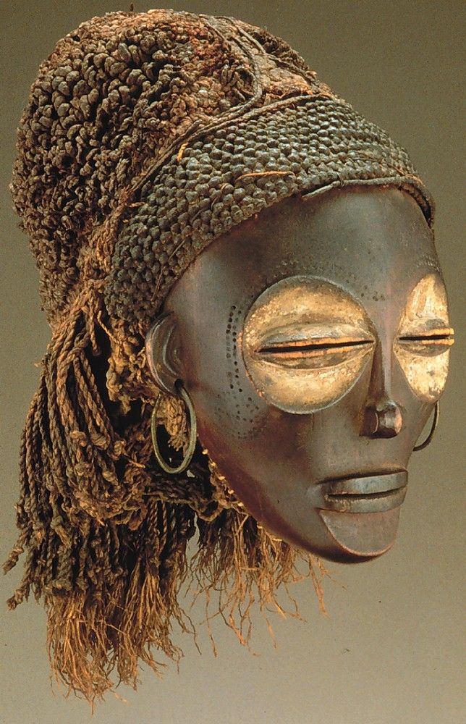
Imperialism?
Exploration?
20th century?
Pre-Colonial?
Where and When?
Notes:
Where and when?
See student worksheet in Teacher Resources on NHD in the Classroom
Pictures
Colonial expansion and exploration in the US:https://www.history.com/topics/westward-expansion/lewis-and-clark
Mexican Revolution in the 20th Century: https://blogs.getty.edu/iris/faces-of-the-mexican-revolution/
Pre-Colonial Africa (Democratic Republic of Congo for this traditional mask):https://www.metmuseum.org/art/collection/search/320516 Imperial China: Paludan, Ann. (1998). Chronicle of the Chinese Emperors: the Reign-by-Reign Record of the Rulers of Imperial China. London: Thames & Hudson Ltd. ISBN 0500050902. Page 177.

Slide 9
Think Local and Personal Too!
West Baton Rouge Museum
Sugar Industry and Agriculture
African American Advancements
Historical Artistic Movements
Southern Louisiana Music
Creole Culture
Family Connection to History
Grandfather’s service in the war
Great-aunt’s activism in the community
Family immigration
Notes:
Tap into all your resources! Local history is important to dive into and explore! There may be connections in your family you do not know about and want to extend further. Ask! Museums and local historical sites are also valuable resources and unique topics! Teachers should encourage their students to pursue local topics!

Slide 10
Narrow Focus
Interest: Agricultural History
Theme: Breaking Barriers
Broad Topic: South LA Agriculture’s Impact
Narrowed Topic: South LA Sugar Industry Engineered New Designs for Agriculture
Make sure your topic is not too complex, too simple, or too recent!!
Notes:
Start with your interest and create a broad topic. Anything too large will be too complex. Narrow down your topic into something that has a considerable amount of research but will not be too simple. Also remember to keep it historical. You can connect your project to current events, but don’t make your project about a current event!! Perhaps use a worksheet to push students to work through a process of figuring out their project through initial research.

Slide 11
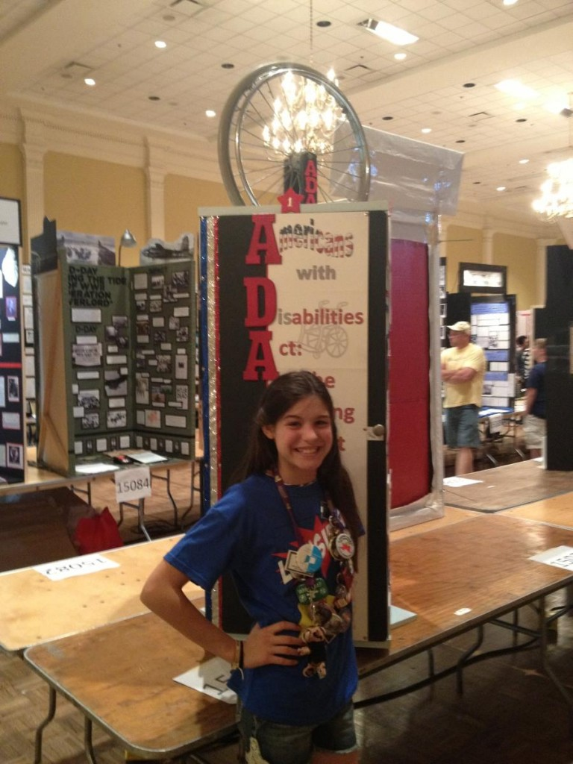
Where to Begin Researching?
Don’t just Google!
Follow your interests and explore:
Libraries/Archives
Online Encyclopedias/Journals
Museums
History Textbooks
https://www.nhd.org/how-enter-contest.
Notes:
Keep a notebook of your research and ideas! Teachers may want their students to fill out a research topic selection sheet to chose their project. See other PowerPoints for researching tips! Consult the NHD website for many resources and rules!
Picture from: http://www.nww2m.com/2013/06/louisiana-students-excel-at-national-history-day-contest/

Slide 12

Contact us with questions! Happy to help!

